Slide 1

RUNGTA COLLEGE OF DENTAL SCIENCES AND RESEARCH
Endodontic instruments
DEPARTMENT OF CONSERVATIVE DENTISTRY AND ENDODONTICS

Slide 2
Specific learning Objectives
At the end of this presentation the learner is expected to know ;
Core areas* | Domain ** | Category #
History | Cognitive | Nice to know
Rotary instruments | Cognitive | Must know

Slide 3
Content
Standardization of Instruments given by Ingle and Levine
Classification of Endodontic Instruments
Group I Hand-operated Instruments
Files
Group II Low Speed Instruments with Latch-Type Design
Group III Engine-Driven Instruments
Generations of NiTi Rotary Files
First Generation NiTi Rotary Files
Second Generation
Third Generation Files
Fourth Generation Reciprocating Instruments
Fifth Generation Instruments
Scout Race Files
Group IV Sonics and Ultrasonics in Endodontics
Sonic Handpiece
Instrument Deformation and Breakage
Instruments Used for Filling Root Canals

Slide 4
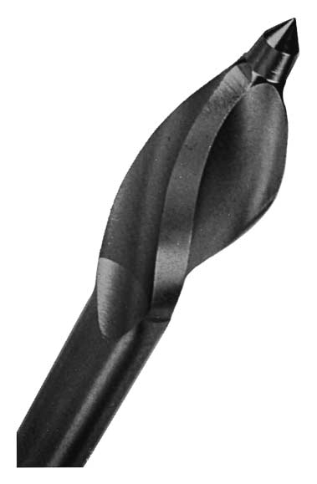
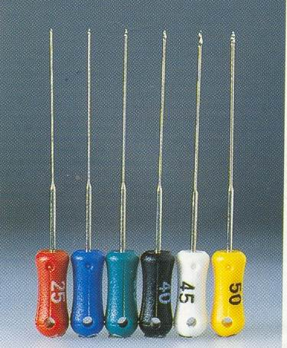
Flexogates/Handygates:
Modification of GG Drill
Hand instrument designed for apical preparation
Non-cutting guiding tip and debris evacuation zone which helps to maintain root canal configuration during instrumentation
The bending movement is well below standard specification for files leading to considerable flexibility in canals
FLEXOGATES
WITH 2MM
CUTTING blade

Slide 5
LIMITATIONS OF STAINLESS STEEL
Stiffness of material
Distortion
Fracture
Pre curvature leads to difficulty in preparation of narrow and curved canal
Limits the apical enlargement to relatively small size.

Slide 6
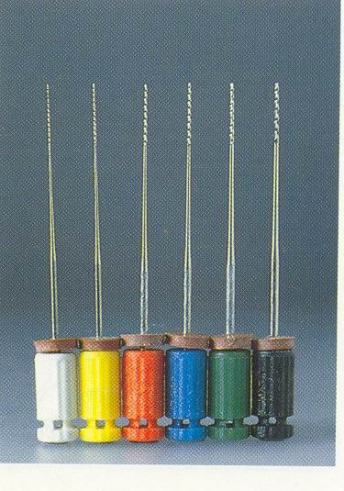
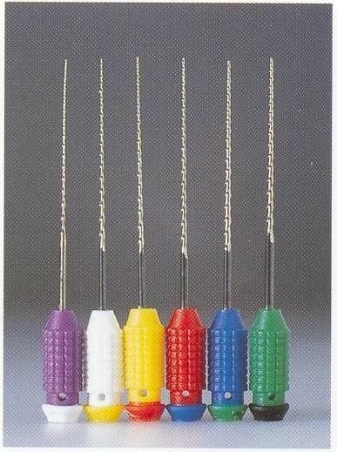
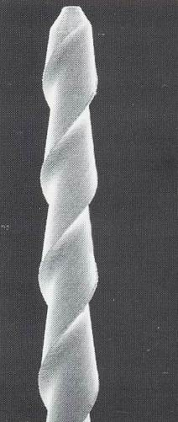
NICKEL TITANIUM ALLOYS
NITIFLEX (MAILLEFER)
K FILES MADE OF NI-TI
HYFLEX-FILES
COMBINE NI-TI MATERIAL
WITH NEW CUTTING DESIGN
SEM PICTURE
OF HYFLEX
Notes:
HYFLEX-X FILES
COMBINE NI-TI MATERIAL
WITH NEW CUTTING DESIG
SEM PICTURE
MICRO TITANIUM INSTRUMENTS
(MICROMEGA)AVIALABLE AS
K REAMERS H FILES
SEM PICTURE
SHAPE MEMORY EFFECT
OF NI-TI FILES

Slide 7
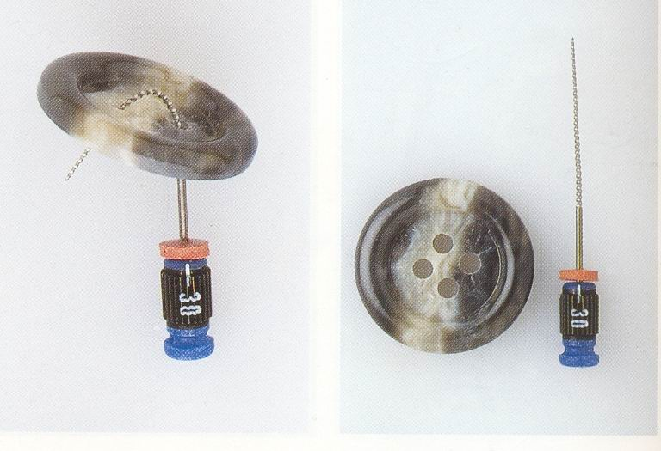
ADVANTAGES OF NICKEL TITIANIUM ALLOYS
2-3 times more elastic flexibility
Superior resistance to fracture
Can retain the shape of curved canals
Undergoes large amount of elastic deformation
Superelasticity & Shape memory
SHAPE MEMORY PROPERTY OF Ni-Ti

Slide 8
DISADVANTAGES OF NICKEL TITANIUM FILES
Cutting efficiency only 60%
Does not give indication of wear before fracture

Slide 9
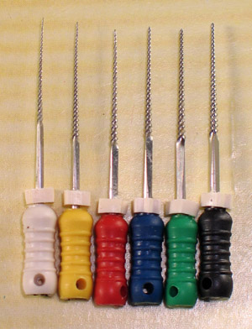
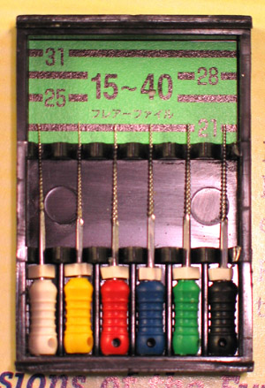
HAND FLARE FILES 5%

Slide 10
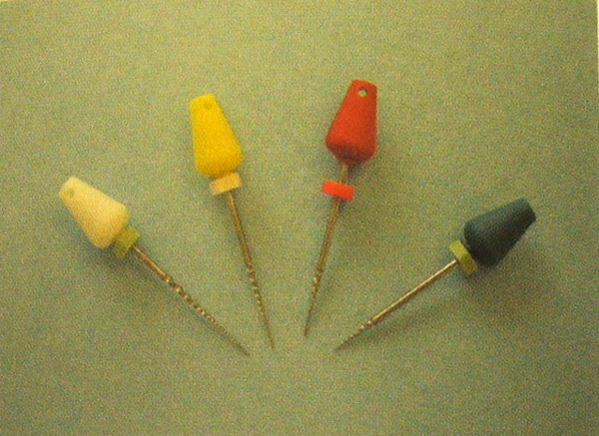
HAND G T FILES

Slide 11
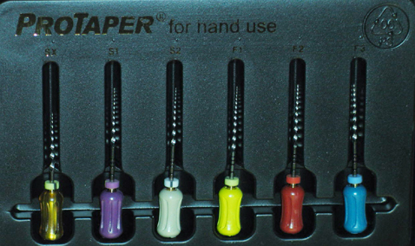
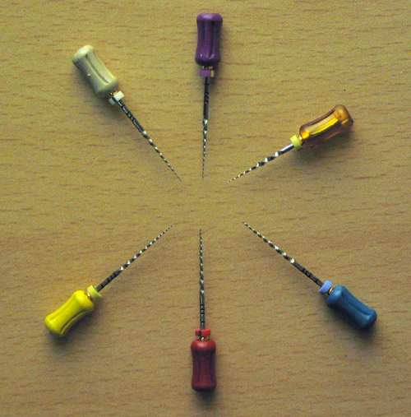
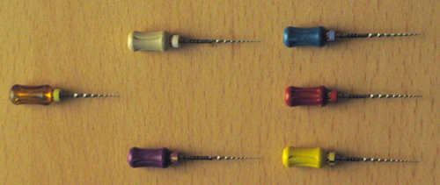
HAND PROTAPER

Slide 12
ROTARY INSTRUMENTS
REDUCTION GEAR CONTRA - ANGLE HANDPIECES
FOR ROTARY INSTRUMENTS USED IN ENDODONTICS

Slide 13
HISTORY & DEVELOPMENT
Reciprocating / quarter turn handpiece
Giromatic
Endo-Cursor
Vertical stroke handpiece
Racer
Canal Finder System
Full rotary handpieces
Latch grip
Friction grip

Slide 14
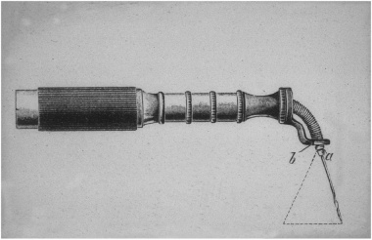
Endodontic Beutelrock-bur in a handpiece with a flexible angle from 1912.

Slide 15
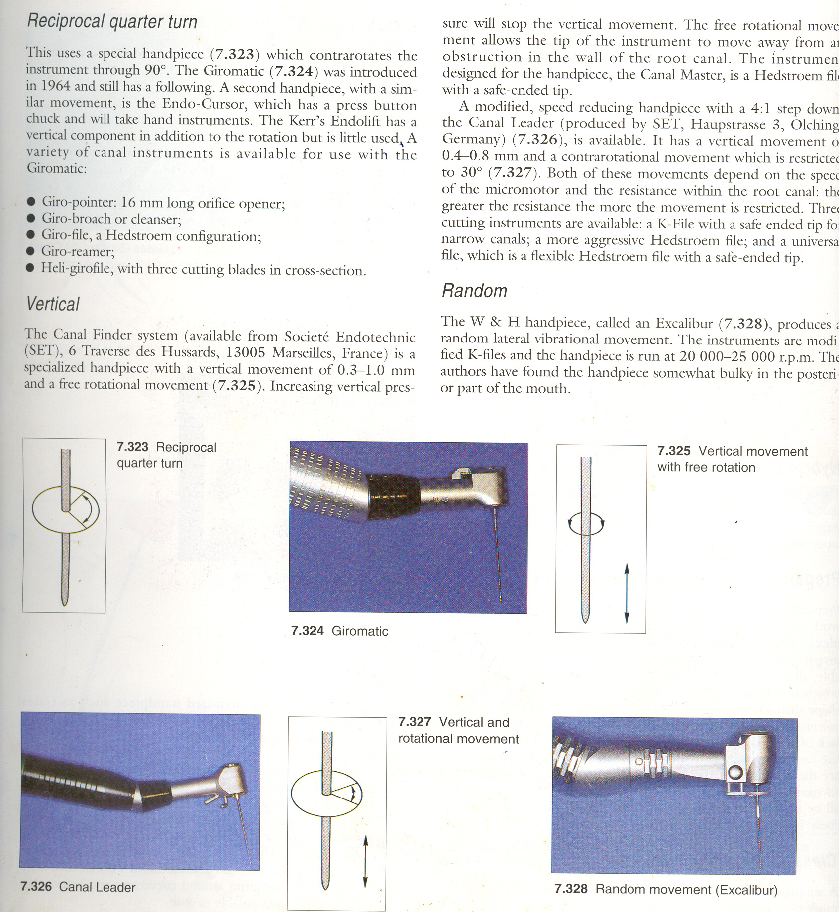
RECIPROCATING / QUARTER TURN HANDPIECES
GIROMATIC
Introduced in 1964 it was the first of the mechanised handpieces

Slide 16
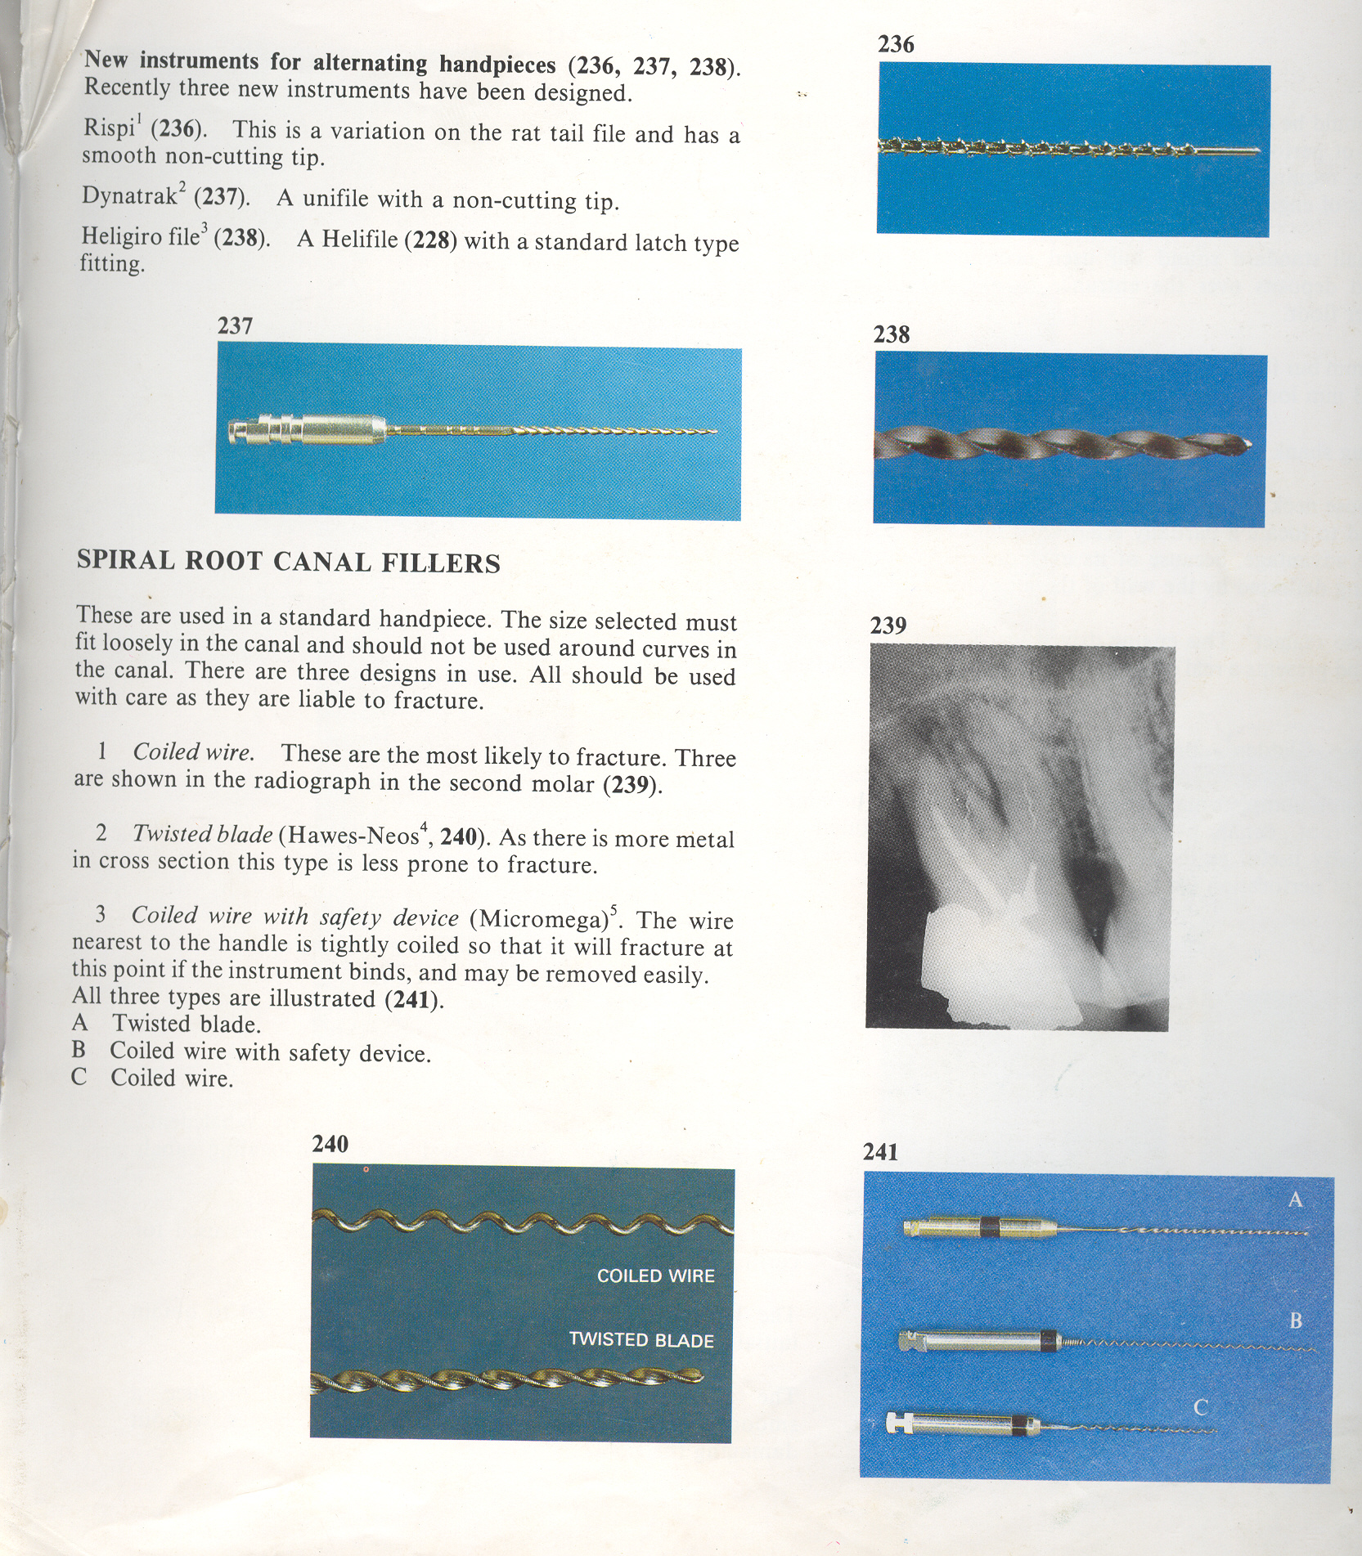
Accepts only latch type instruments
Giro-broach or Giro-cleanser (latch type broaches)
Giro-files (latch type Hedstroem files)
Giro- reamer (latch type K style reamers)
Heli-girofiles (latch type Helifile)
HELI-GIROFILE

Slide 17
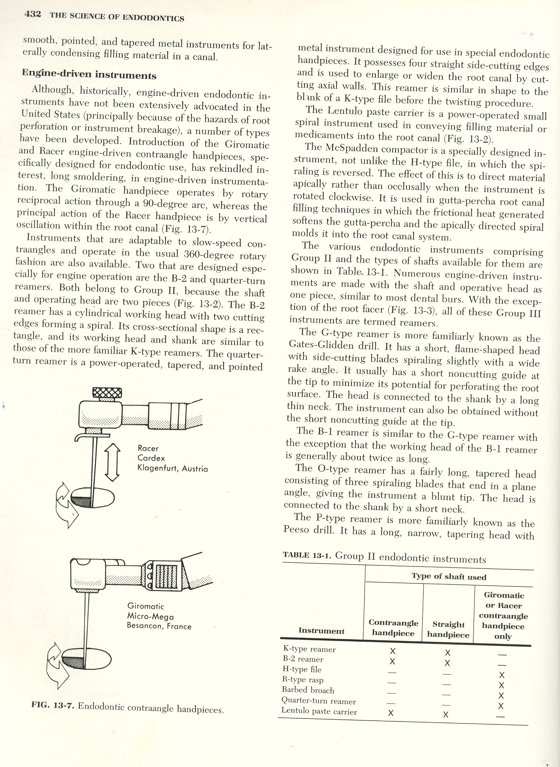
Uses a quarter turn (90⁰) reciprocating motion
Speed – 3000 rpm

Slide 18
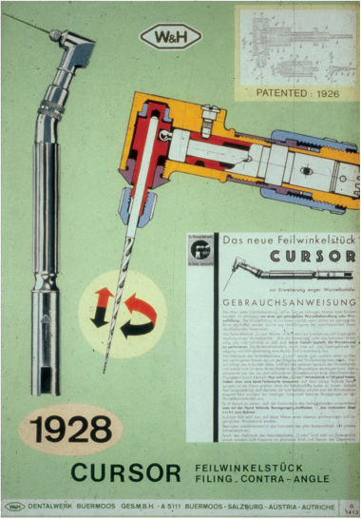
RECIPROCATING / QUARTER TURN HANDPIECES
ENDO-CURSOR
4:1 Reduction Handpiece
Has a “Press Button type chuck”
Spring chuck holds standard hand instruments

Slide 19
RECIPROCATING / QUARTER TURN HANDPIECES
Uses a quarter turn (90⁰) reciprocating motion (similar to Giromatic)

Slide 20
REDUCTION GEAR CONTRA – ANGLE HANDPIECES USED IN ENDODONTICS
Reciprocating / quarter turn handpiece
Giromatic
Endo-Cursor
Vertical stroke handpiece
Racer
Canal Finder System
Full rotary handpieces
Latch grip
Friction grip

Slide 21
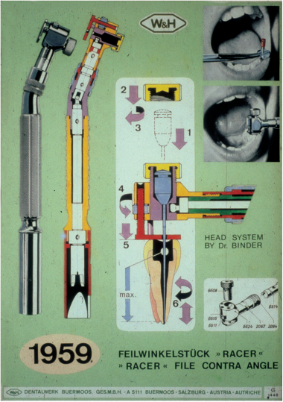
VERTICAL STROKE HANDPIECE
RACER
Uses a standard file
Length of the instrument can be adjusted
Oscillates the file in the canal
Major disadvantage
Debris forced ahead of instrument into periapical tissue
Access to the apical foramen must always befirst made with hand reamers or files

Slide 22
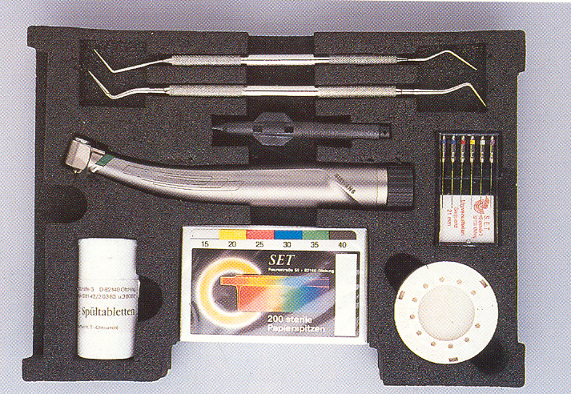
VERTICAL STROKE HANDPIECE
CANAL FINDER SYSTEM
Speed 1000-8000 rpm
Delivers a vertical stroke of 0.3 to 1 mm
Also has a quarter turn reciprocating motion when instrument binds
Uses an ‘A’ file (a Hedstroem file with a safe ended tip)

Slide 23
REDUCTION GEAR CONTRA – ANGLE HANDPIECES USED IN ENDODONTICS
Reciprocating / quarter turn handpiece
Giromatic
Endo-Cursor
Vertical stroke handpiece
Racer
Canal Finder System
Full rotary handpieces
Latch grip
Friction grip

Slide 24
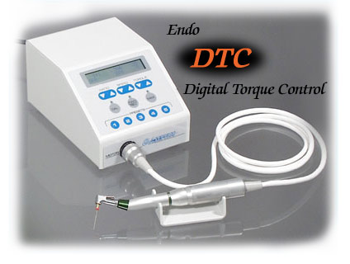
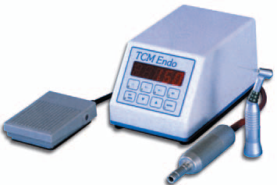
FULL ROTARY HANDPIECES
SLOW SPEED HANDPIECES

Slide 25

FULL ROTARY HANDPIECES
MM324 reduction gear handpiece
This versatile air motor provides high torque at low speed
runs quietly and is easy to maintain
The motor may also be paired with the Micro Mega MM10TE Contra Angle.

Slide 26
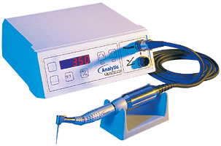
FULL ROTARY HANDPIECES
Quantec-ETM Electric Torque-Control Motor
an auto-reverse function that initiates when reaching a predetermined level of resistance
There are five settings plus one that inactivates the feature.
has a 110-20,000 rpm speed range
is designed for use with an 1:1 or 18:1 reduction contra-angle.
The unit is compatible Quantec or K3 Files

Slide 27
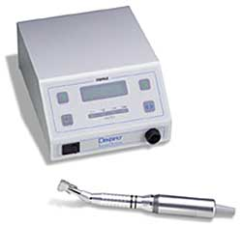
FULL ROTARY HANDPIECES
Aseptico Electric Motor
Digital, slow-speed, high-torque electric motor for endodontic canal preparation.
Features autoclavable brushless motor/cable assembly
digital RPM readout

Slide 28
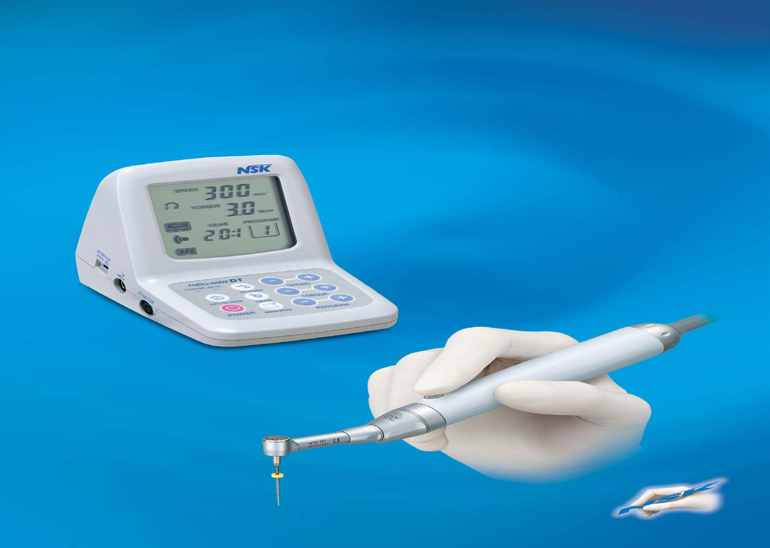

Slide 29
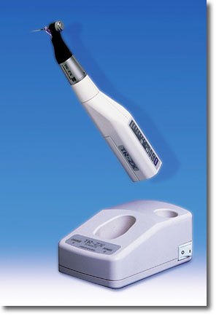
FULL ROTARY HANDPIECES
Tri-Auto ZX Hand Piece
Combined with the technology and accuracy of the Root ZX Apex Locator, this hand piece has the capability and convenience to electronically monitor the root canal before, during and after instrumentation.

Slide 30
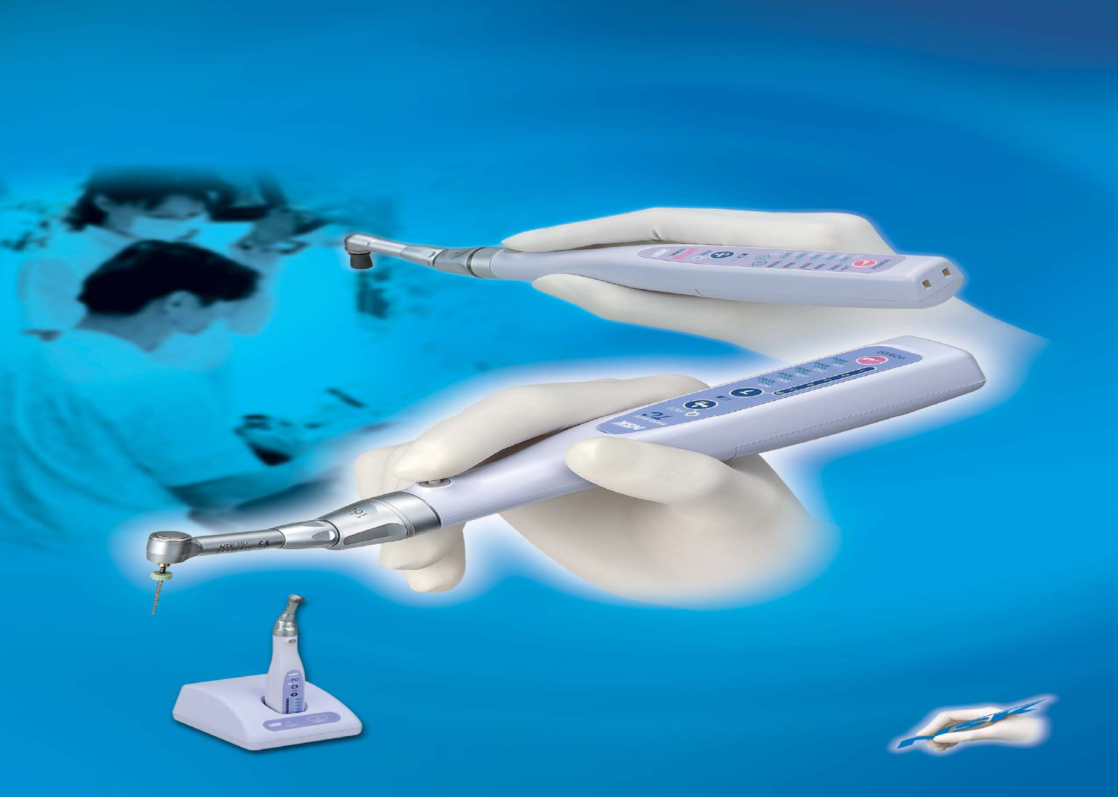
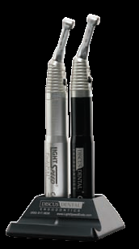
Endo pal
Endo Mate cordless hand piece

Slide 31
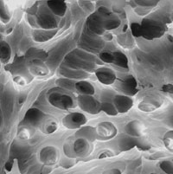
TAKE HOME MESSAGE
From a biological perspective, root canal treatment is directed toward the elimination of micro-organisms from the root canal system and the prevention of reinfection.
Technological advances in the form of rotary NiTi instruments have led to dramatic improvements in the ability to shape root canals with potentially fewer procedural complications.

Slide 32
QUESTIONS
What are flexo gates?
What are nickel titanium alloys?

Slide 33
REFERENCES
Endodontic Practice 11th Edn. Grossman
Pathways Of The Pulp 6th Edn. & 9th Edn. Cohen
Endodontics Vol 1 Arnaldo Castellucci
Endodontics Ingle 5th Edn.
Text book of Endodontology Bergenholtz Reitz
Endodontic Therapy Weine 5th Edition
Color atlas of Endodontics William Johnson
Principles and practice of Endodontics- Walton &Torabinejad
Color Atlas of Microsurgery in Endodontics Syngcuk Kim
Textbook of Endodontics Nisha Garg Amit Garg

Slide 34
THANKYOU

